Slide 1


1
String manipulation in Excel
Presented by: Data Team

Slide 2
What you will learn?
In this section, participants will learn various ways of manipulating and working with strings. Functions such as LEFT, RIGHT,MID, FIND/SEARCH shall be covered.
Bonus: Flashfill as an alternative

Slide 3
What you will learn?
Participants will also learn how to clean data in Excel using functions like LOWER(), UPPER(), PROPER(), TRIM, CLEAN, etc.

Slide 4
Introduction to string manipulation in Excel
LEFT()
Description
LEFT returns the first character or characters in a text string, based on the number of characters you specify
= LEFT(text, [num_chars])
The function syntax has the following arguments:
Text Required. The text string that contains the characters you want to extract.
Num_chars Optional. Specifies the number of characters you want LEFT to extract.

Slide 5
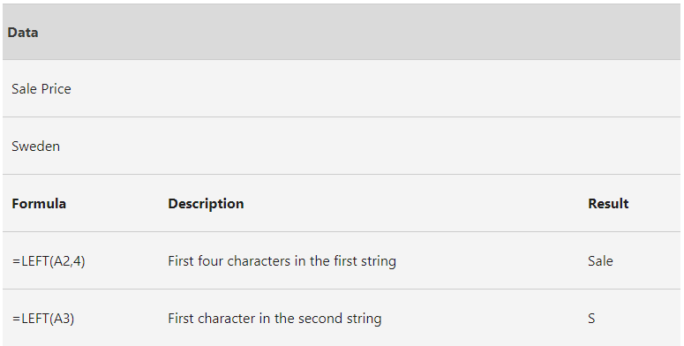
Introduction to string manipulation in Excel
Example
COVID-19
C

Slide 6
Introduction to string manipulation in Excel
RIGHT()
Description
RIGHT returns the last character or characters in a text string, based on the number of characters you specify.
= RIGHT(text, [num_chars])
The function syntax has the following arguments:
Text: The text string containing the characters you want to extract.
Num_chars: Optional. Specifies the number of characters you want RIGHT to extract.

Slide 7
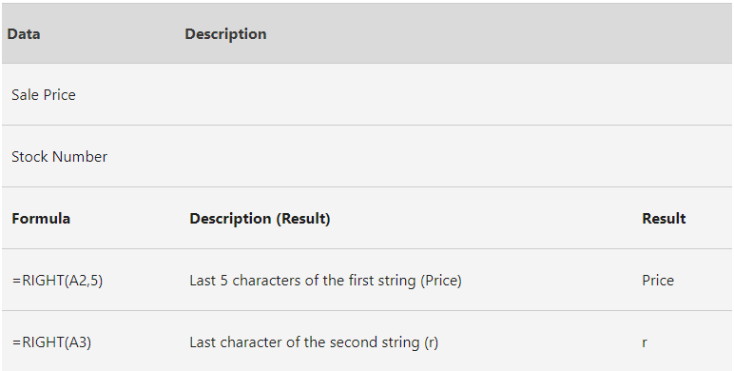
Introduction to string manipulation in Excel
Example

Slide 8
Introduction to string manipulation in Excel
MID()
Description
MID returns a specific number of characters from a text string, starting at the position you specify, based on the number of characters you specify.
= MID(text, start_num, num_chars)
The function syntax has the following arguments:
Text The text string containing the characters you want to extract.
Start_num: The position of the first character you want to extract in text. The first character in text has start_num 1, and so on.
Num_chars: The number of characters you want MID to return from text.

Slide 9
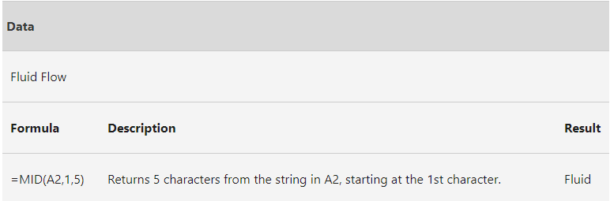
Introduction to string manipulation in Excel Example

Slide 10
Introduction to string manipulation in Excel
FIND()
Description
FIND returns the starting position of one text string within another text string. FIND is case-sensitive.
FIND(find_text, within_text, [start_num])
Check SEARCH(find_text, within_text). SEARCH is not case-sensitive.
The function syntax has the following arguments:
Find_text The text you want to find.
Within_text The text containing the text you want to find.

Slide 11
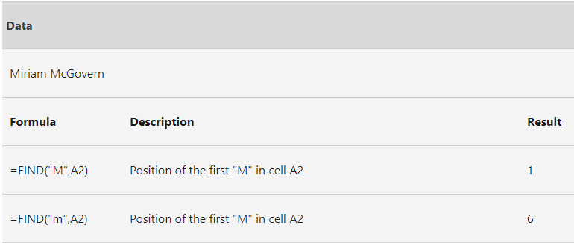
Introduction to string manipulation in Excel Example

Slide 12
Introduction to string manipulation in Excel
FIND() can help MID() to locate its start_num i.e.
MID(text, FIND(find_text, within_text), num_chars)
start_num

Slide 13
Introduction to string manipulation in Excel
Change cases (lower, upper, and proper)
Concatenation (using & or CONCATENATE() function)
trim and clean functions

Slide 14

Lab session

Slide 15


Thank You

